Slide 1


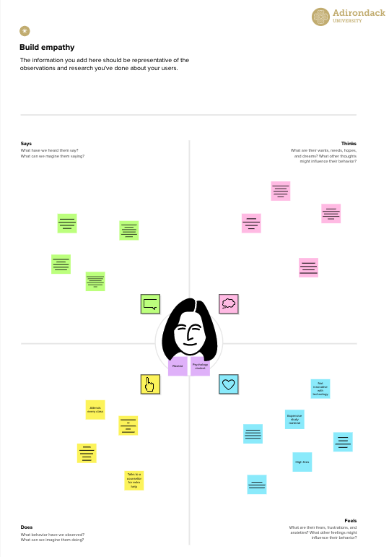




Template
✴
Build empathy
The information you add here should be representative of the observations and research you've done about your users.
Empathy map
Use this framework to develop a deep, shared understanding and empathy for other people. An empathy map helps describe the aspects of a user's experience, needs and pain points, to quickly understand your users’ experience and mindset.
Says
What have we heard them say? What can we magine them saying?
Thinks
What are their wants, needs, hopes, and dreams? What other thoughts might influence their behavior?
is this an accurate prediction
it is easy to use
can i trust the results?
on what basis the model is giving the results
predictions are accurate
overall experience is good
Give them a name and a portrait to empathize with your persona.
user enters the data
helps the user to identify whether they have thyroid disease or not
anxious - about the results
user interacts with the UI
good - user experience
overwhelmed
- need to enter too many data
Does
What behavior have we observed? What can we imagine them doing?
Feels
What are their fears, frustrations, and anxieties? What other feelings might
influence their behavior?
Share template feedback
Need some inspiration?
See a finished version of this template to kickstart your work.
Open example

